Slide 1
Welcome to CodePath!
TIP101
Notes:
🌟 Purpose: Introduce students to the course and set a positive tone for learning.
✅ What should I be doing?
Welcome students as they join, ensuring energy and enthusiasm.
Confirm the session details and greet students by name if possible.
🎙️ What should I be saying?
Welcome to CodePath TIP101! I’m so excited to have all of you here. Over the next 10 weeks, we’ll dive into Python programming and technical interview preparation.
🙌🏽 How should I engage students?
Ask students to share their location or one word describing how they feel about starting the course in the chat.

Slide 2
1 | Welcome 👋🏽 | 15 minutes
2 | Course Structure & Resources | 30 minutes
3 | BREAK | 5 minutes
4 | Collaborative Problem Solving | 60 minutes
5 | Wrap Up | 10 minutes
Notes:
🌟 Purpose: Provide a clear overview of the session.
✅ What should I be doing?
Walk through the agenda and ensure students understand the schedule.
🎙️ What should I be saying?
Today, we’ll start with a welcome and overview, move into course structure and resources, take a short break, and end with collaborative problem-solving.
🙌🏽 How should I engage students?
Pause to ask if anyone has questions about the flow of the session.

Slide 3
Welcome! 👋🏽
15 minutes

Slide 4

Cory Brooks
ex-Amazon/AWS SWE, ex-Wall Street SWE
NLP, AI, Computational Finance, Music Production,
Education:
Georgia Tech
B.S. Computer Science
Concentration in AI & Human-Computer Interaction
“You’ll never know if you don’t try.”
Notes:
🌟 Purpose: Personalize the course by sharing your background and interests.
✅ What should I be doing?
Update this slide with your name, expertise, and education.
🎙️ What should I be saying?
A little about me: [Your name], my background is in [field], and I’ve worked on [relevant projects]. I’m here to support your learning journey!
🙌🏽 How should I engage students?
Invite students to share their own goals or backgrounds in the chat.

Slide 5

Turn on your cameras!
Notes:
🌟 Purpose: Encourage students to engage visually for better interaction.
✅ What should I be doing?
Kindly ask students to enable their cameras.
🎙️ What should I be saying?
Let’s see all your wonderful faces! It makes the session more interactive and fun.
🙌🏽 How should I engage students?
Acknowledge students who turn on their cameras with positive reinforcement.
This is where the team introduces the readiness prep form

Slide 6
5 minutes
✈️ Question:
What got you into technology / interested in taking this course?
💬 Answer:
In the Zoom chat, please paste the city! Add an emoji react to the ones that you would also like (or share recommendations if you’ve been!)

Slide 7
Course Structure & Resources
30 minutes

Slide 8
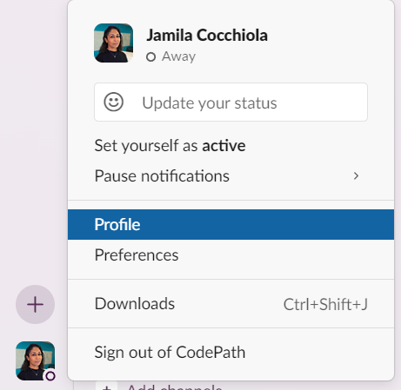
3 minutes
Updating Your Slack Handle: Make sure your Slack name is formatted as
Name Field: FirstName LastName Title Field: Level, Section
For example: Name: Tony Stark Title: TIP101, S1
✅ Take a moment to do this now!
Notes:
🌟 Purpose: Ensure students are set up correctly in Slack.
✅ What should I be doing?
Demonstrate how to update Slack handles and monitor for completion.
🎙️ What should I be saying?
Your Slack handle should include your name and course level. Let’s take a moment to update this now.
🙌🏽 How should I engage students?
Provide support in real-time for anyone facing issues.

Slide 9
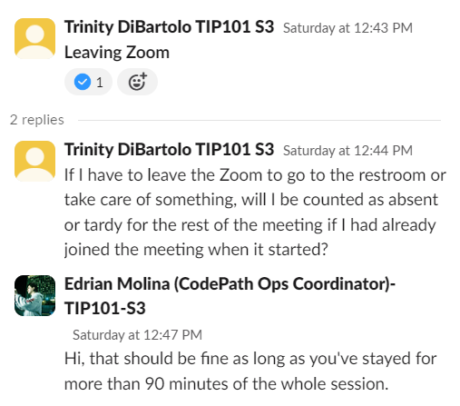
Threads on Slack
When starting a new conversation, start by posting the topic. Within the thread of that topic, provide the additional details about your question or request.
Notes:
🌟 Purpose: Teach effective communication practices in Slack.
✅ What should I be doing?
Share examples of effective thread usage.
🎙️ What should I be saying?
Starting a thread helps keep our discussions organized. Let’s practice now.

Slide 10
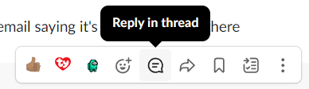
2 minutes
Let's practice!
I will post a message in the #dts-su26-tip101-program-help channel.
Reply to that message by replying in the thread.
Notes:
🌟 Purpose: Reinforce the importance of Slack thread etiquette.
✅ What should I be doing?
Guide students through replying in a thread.
🎙️ What should I be saying?
Reply in the thread I’ve started in the #tip101-program-help-fall24 channel.
🙌🏽 How should I engage students?
Call out exemplary replies to encourage participation.

Slide 11
Class Structure
2 sessions per week – Tuesdays and Thursdays
45 min Guided Exploration
1 hour Collaborative Problem Solving
TFM (Primarily Neel is substituting for today) will usually take over in the 2nd half of class, , after we complete our instructor slides.
Optional Study Halls each week
See the Course Portal -> Schedule tab for more!
Weekly HackerRank assessment due Sundays at 11:59pm PST
Notes:
🌟 Purpose: Outline the weekly schedule and expectations.
✅ What should I be doing?
Walk through the schedule and answer any questions.
🎙️ What should I be saying?
You’ll have two sessions a week plus optional office hours for extra help.

Slide 12
Adaptive Pacing
During the Collaborative Problem Solving time, you will be in breakout rooms of 3 to 6 students.
Skip units by passing the HackerRank assessment.
If you look at the Collaborative Problem Solving questions and you can self-practice, take the assessment early.
Keep working on a unit until you pass the HackerRank assessment (up to 2 attempts).
Notes:
🌟 Purpose: Address different learning paces and encourage collaboration.
✅ What should I be doing?
Explain how breakout rooms and assessments are designed for varied pacing.
🎙️ What should I be saying?
This course is self-paced but collaborative. You’ll move at your pace but work with peers at the same level.

Slide 13
🏆 Benefits for Course Completion
All students who meet the attendance requirements and pass 6 HackerRank assessments will be considered a CodePath alumni and:
Receive a (digital) CodePath certificate of completion.
Gain access to CodePath alumni networks.
Notes:
🌟 Purpose: Motivate students by sharing the rewards of completing the course.
✅ What should I be doing?
Highlight the alumni benefits and other opportunities.
🎙️ What should I be saying?
Completing this course unlocks amazing opportunities like alumni networks and mentorship.

Slide 14
Policies: Attendance
Attendance at all sessions is mandatory.
You are allowed up to 3 absences throughout the entire program.
You do not need to submit a request to use these absences.
Students who are absent must still submit the coursework for a unit by the posted deadline.
Notes:
🌟 Purpose: Inform students about the attendance policy and its importance.
✅ What should I be doing?
Clearly explain the attendance policy and its role in course success.
🎙️ What should I be saying?
Attendance is critical to your success in this course. You’re allowed up to 3 absences, but it’s important to stay consistent to get the most out of the experience.
🙌🏽 How should I engage students?
Ask: "Why do you think consistent attendance is important for a course like this?"

Slide 15

How do I get the most out of this course?
Engage in class fully! That means . . .
Taking notes
Speaking up
Using the tools and strategies
Notes:
🌟 Purpose: Encourage students to participate actively during sessions.
✅ What should I be doing?
Emphasize how engagement improves outcomes.
🎙️ What should I be saying?
This course works best when you fully engage. Take notes, ask questions, and share your ideas. These habits will help you retain what you learn.
🙌🏽 How should I engage students?
Ask students to share one strategy they plan to use to stay engaged.

Slide 16

How do I get the most out of this course?
Practice! Practice! Practice!
Notes:
🌟 Purpose: Highlight the importance of consistent practice.
✅ What should I be doing?
Stress the value of daily practice.
🎙️ What should I be saying?
Practice is key to mastering Python and interview techniques. Try to code daily, even if it’s just for a short time.
🙌🏽 How should I engage students?
Ask: "What’s one way you plan to make time for daily practice?"

Slide 17
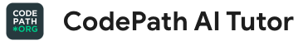
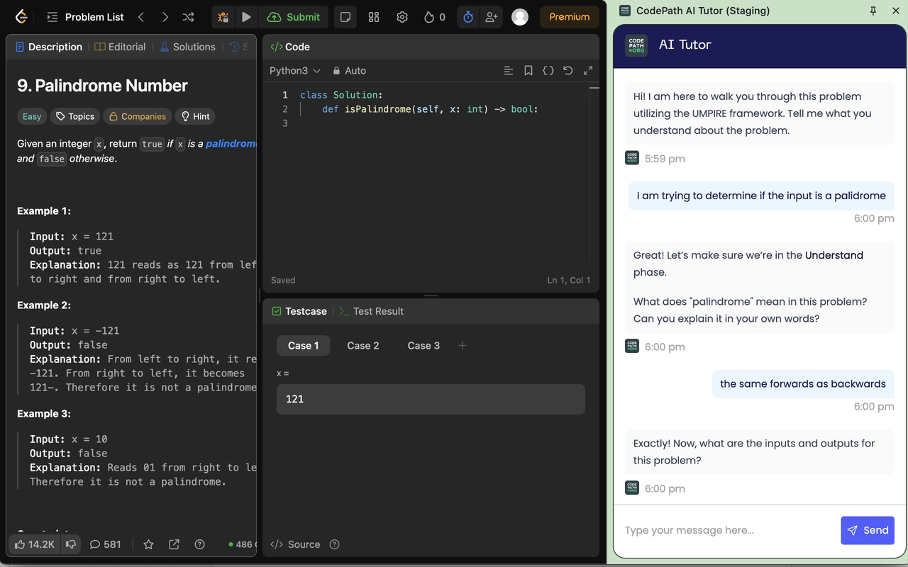

How do I get the most out of this course?
Build your skills with support! Take the following steps:
Install the AI Tutor on chrome: https://go.codepath.org/tiptutor
Solve 2 LeetCode problems on 2 different days
Once you’ve taken the steps above, unlock a new opportunity!
+1 absence back for completion(one-time offer)
Take a look at the FAQ if you have any questions
Notes:
🌟 Purpose: Show the new CodePath AI Tutor.
✅ What should I be doing?
Encourage the use of the new AI Tutor: https://go.codepath.org/tiptutor
Specifically for use with LeetCode problems
🎙️ What should I be saying?
It’s common to get stuck on a difficult problem when practicing independently. Try using the AI Tutor as a way to get unstuck, guiding you through the UMPIRE method for the problem.
🙌🏽 How should I engage students?
Complement your additional practice with the support and guidance from the AI Tutor.

Slide 18

How do I get the most out of this course?
Aim for one passed unit per week
Pass = 6 Units minimum
Notes:
🌟 Purpose: Set realistic goals for progress.
✅ What should I be doing?
Encourage students to aim for steady progress.
🎙️ What should I be saying?
Completing one unit per week is a good target. If you need more time, that’s okay too, but staying consistent is important.
🙌🏽 How should I engage students?
Prompt: "What strategies will you use to stay on track with this goal?"

Slide 19

How do I get the most out of this course?
Share gratitude and shoutouts regularly
Notes:
🌟 Purpose: Build a positive and supportive learning environment.
✅ What should I be doing?
Encourage students to share appreciation for their peers.
🎙️ What should I be saying?
Expressing gratitude helps build a strong community. Let’s celebrate each other’s wins throughout the course.

Slide 20
Be Fully Present
In the session for at least 90 minutes
Fully engaging visually, verbally, and technically without reminders, requests, or interruptions
Notes:
🌟 Purpose: Emphasize the need for focused participation.
✅ What should I be doing?
Define what "being fully present" means in a virtual classroom.
🎙️ What should I be saying?
To get the most out of this course, be present visually, verbally, and technically. Limit distractions and actively contribute.
🙌🏽 How should I engage students?
Ask: "What are some ways you stay focused during online sessions?"

Slide 21
5 minutes
What do you think it means to be fully engaging visually, verbally, and technically without reminders, requests, or interruptions? What do you think this looks and sounds like?
Notes:
🌟 Purpose: Facilitate a discussion about active engagement.
✅ What should I be doing?
Guide students to reflect on participation expectations: being on camera and mic, having a stable internet connection, and being in a distraction-free environment.
Mention that bathroom breaks are okay and how to handle them appropriately by fully exiting the Zoom, and re-entering after their bathroom break.
Explain why these requirements are crucial for a productive learning experience, and give practical tips on how to create an optimal setup.
🎙️ What should I be saying?
What does it look like to be fully present? Let’s brainstorm ideas together.
🙌🏽 How should I engage students?
Summarize student responses and provide practical tips for participation.

Slide 22


Having Trouble?
I need help or have questions about Slack, the course structure, etc.
Attend a weekly Fix-It Garage Session.
I need help or have questions about Python or understanding a problem.
Attend a weekly Study Hall.
Notes:
🌟 Purpose: Introduce resources for resolving issues and getting help.
✅ What should I be doing?
Explain the purpose of Fix-It Garage and Study Hall sessions.
🎙️ What should I be saying?
If you run into technical issues or need help with coding problems, these sessions are here for you. Don’t hesitate to use them!

Slide 23
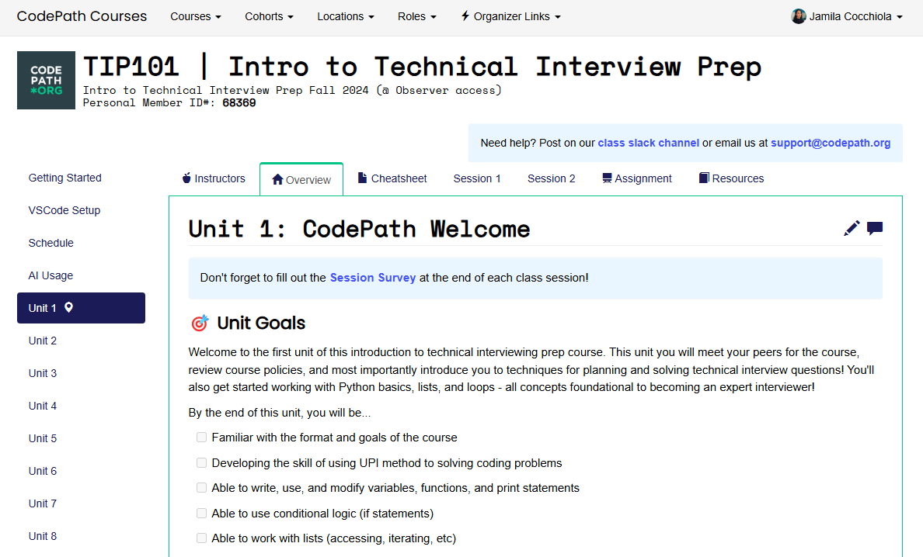
5 minutes
Let’s check out the Course Portal!
Notes:
🌟 Purpose: Familiarize students with the course portal and its features.
✅ What should I be doing?
Navigate the portal live and highlight key sections.
Go to https://courses.codepath.org/courses/tip101
Show the Session 1 breakout room problems – this is what we will be working on today.
Show the Assignment page and explain different versions.
Show the Resources tab and highlight the cheatsheet.
Show the Career tab with milestones to prepare for other aspects of interviews.
🎙️ What should I be saying?
Let me show you the Course Portal where you’ll find assignments, resources, and career tools.
🙌🏽 How should I engage students?
Pause for questions and ask if there’s a feature they’re particularly excited about.

Slide 24
10 minutes
Python and VS Code Tour
Unit 1 Cheat Sheet
General Python Cheat Sheet
Notes:
🌟 Purpose: Introduce students to Python and VS Code basics.
✅ What should I be doing?
Demonstrate creating and running a Python file in VS Code.
Open VS Code.
Create a new Python file.
Explore the cheatsheet via VS Code.
Run the example usage print statements from the Unit 1 Cheatsheet in VS Code as a demo.
(Optional) Go through the rest of the cheatsheet noting any important information.
🎙️ What should I be saying?
Here’s how you can set up your Python environment and run your first script. Let’s use the Unit 1 cheat sheet to guide us.
🙌🏽 How should I engage students?
Encourage students to follow along if they have VS Code installed.

Slide 25
Readiness Prep Form

Slide 26

Break Time!
Take 5 mins to step away from the computer. Feel free to turn off your camera and return promptly after 5 mins.
Notes:
🌟 Purpose: Provide a short break to refresh and re-energize.
✅ What should I be doing?
Announce the break and remind students to return on time.
Play the countdown timer video (be sure to share sound).
🎙️ What should I be saying?
Let’s take 5 minutes to step away from the screen. Be sure to return promptly.

Slide 27
Collaborative Problem Solving
60 minutes

Slide 28
5 minutes
What does Collaborative Problem Solving look like?
Let’s observe! 👀
Notes:
🌟 Purpose: Demonstrate effective collaborative problem-solving.
✅ What should I be doing?
Model how to introduce yourself, share the screen, and start solving a problem.
🎙️ What should I be saying?
Let’s go through an example of how you can work together effectively in breakout rooms.
🙌🏽 How should I engage students?
Ask students what they notice about the demo and discuss effective practices.

Slide 29
55 minutes
🏃🏽 Navigate to your breakout room.
👋🏽 Introduce yourselves!
🧑🏽‍💻 Work on the problems for your selected unit.

Slide 30
Wrap Up
10 minutes

Slide 31
Notes:
🌟 Purpose: End the session on a positive note.
✅ What should I be doing?
Prompt students to share their reflections in the chat.
🎙️ What should I be saying?
Let’s celebrate your wins. Share one good thing you learned or accomplished today!
🙌🏽 How should I engage students?
Read a few responses aloud and celebrate with enthusiasm.

Slide 32


Session Survey Time!
Notes:
🌟 Purpose: Gather feedback to improve future sessions.
✅ What should I be doing?
Share the survey link and emphasize its importance.
🎙️ What should I be saying?
Your feedback helps us make these sessions even better. Please take a moment to complete the survey.
🙌🏽 How should I engage students?
Thank students for their input and explain how feedback has been used in the past.

Slide 33

Final Reminders
Finish the problem sets for additional practice
Take the weekly HackerRank assessment by Sunday @ midnight
Join a Fix-it-Garage Session to untangle technical hiccups
Visit a Study Hall Session to deepen your understanding, work through challenges, and connect with course material alongside your peers!
Notes:
🌟 Purpose: Reinforce key tasks and deadlines.
✅ What should I be doing?
Summarize next steps and encourage continued engagement.
🎙️ What should I be saying?
Don’t forget to complete the problem sets and take the HackerRank assessment by Sunday!
🙌🏽 How should I engage students?
Encourage students to ask any lingering questions before signing off.

